Slide 1

Partnership for Safe Water Distribution System Optimization Program
PWD Program

Slide 2
Briefing Agenda
Overview
Charlie Zitomer
Phase 2 Annual Submittal
Brendan Reilly - Overview of Phase 2 report, pressure (reporting anomalies) and main break data
Dennis O’Connor - Cl₂ residual trend, activities and reporting software anomalies.
Phase 3 Self-assessment
Rita Kopansky - PLF, PI² and Partnership & PaDEP Reporting of Disinfectant Residual
Joe Yeager - Interview process and summary sheets for steering committee to vet and approve
Christine Marjoram - PLF and PI², main breaks and water master plan

Slide 3






How the Partnership for Safe Water Began?
Established in 1995 to address Cryptosporidium concerns
Partner organizations:

Slide 4
Partnership for Safe Water Mission
“The Partnership's mission is to improve the quality of drinking water delivered to customers of community water supplies by optimizing system operations.”

Slide 5
Water Research Foundation Project #4109 (Criteria for Optimized Distributions Systems)
Published in 2010
Defines and develops a continuous improvement program for water distribution system operations.
Identifies metrics to aid in identifying where optimization efforts can best be focused.

Slide 6


PSW Optimization Programs
Treatment Plants –Started in 1995
Optimization program metrics were well defined:
Sed. basin effluent goals; < 1.0 ntu 95 % of measurements
individual filtered effluent < 0.1 ntu 95% of measurements
filter performance protocols – filter backwash, filter ripening & stepped return to service procedures
Distribution Systems –Started January 2011
Optimization program metrics are evolving.
Requirements include:
One-year baseline data collection period for chlorine residual, district pressures and main break data
19 PIVs to be assessed against Best Management Practices
Founding Member practices will be used as a benchmark for future program participants

Slide 7
Two Programs - One System
Phase I-commitment
– Agree to submit annual performance data and complete program through Phase III
Phase II - baseline data and annual data
– Submit annual performance data
Phase III-self-assessment
– Complete a self-assessment and submit a report
Phase IV-optimization
– Achieve full optimization

Slide 8
Achievement Awards
Phase III - Directors Award
– Satisfactory completion of self-assessment report
– Additional Awards for maintaining level for
5-, 10-, and 15-years
Phase IV - Excellence Award
– Highest possible level of performance
– Additional Awards for maintaining level for
5-, 10-, 15-years

Slide 9
PWD DSOP Project Plan
Kickoff - 9/27/11 and formation of Steering Committee
Task I – Collect & Submit Baseline Data;
Water Quality - disinfectant residual
Hydraulic - pressure management
Physical - main break frequency
Task II – Conduct Self-assessment of 19 PIVs
Self-assessment Team interviews Subject Matter Experts to evaluate PWD activities
Task III - Submit Annual Reports and Self-assessment Report

Slide 10
Distribution System Integrity
System Integrity Performance Indicators
Water Quality
Maintain Disinfectant Residual
Hydraulics
Maintain Positive Pressure
Physical
Main Break Frequency Reduction
System Integrity may be at risk when these performance indicators are not optimized
Notes:
In PSW DSOP, there are three main indicators for distribution system integrity performance.
Water Quality, particularly in regards to maintaining disinfectant residual, is a crucial optimization component in preserving distribution system integrity.
If all three integrity components are optimized, high water quality and system reliability can be enhanced.

Slide 11
19 Performance Improvement Variables (65 questions for gauging optimization)
(5) Disinfectant Residual
(4) Cross-Connection Control
(2) Customer Complaints
(2) DBP Control
(3) Energy Management
(4) External Corrosion Control
(3) Flushing
(5) Hydrant/Valve Maintenance
(3) Internal Corrosion Control
(3) Main Breaks
(2) Nitrification
(3) Pipe Rehab. & Replacement
(3) Inorganic Accumulation Control
(8) Pressure Management
(3) Security and Online Monitoring
(4) Storage Tank O&M
(3) Water Age Management
(2) Water Loss Control
(3) Water Sampling and Response

Slide 12
Distribution System Annual Report Data
PSW keeps all data confidential
Disinfectant Residual results from routine sample sites throughout the distribution system
PSW provides data collection software including;
daily minimum Cl2 value reported
location/site ID
sites with a low residual value are reported

Slide 13
PWD’s Distribution System Optimization Program Approach
Partnership acceptance by Commissioner
Team approach to get the correct information and involve the right parties
Project Manager
Steering Committee
Self-assessment Team
Subject Matter Experts

Slide 14
PWD Project Structure
Steering Committee
Led by project manager, consists of leaders within utility whose organization would be impacted by SA process, monthly meetings to develop framework for and oversee project
Self-assessment Team
Composed of younger professionals, 3 groups based on Performance Improvement Variables, managed and directed details of SA process and summary interview documents
Subject Matter Experts
Experienced technical staff, participated in interviews with SA Team, reviewed findings and recommendations, Steering Committee members also participated as SMEs

Slide 15
PWD Steering Committee Members
Charles Zitomer, Assistant General Manager of Field Services
Steve Furtek, General Manager of Engineering Division
Christine Marjoram, Director of Planning & Research
Rita Kopansky, Water Quality & Research Manager
John Muldowney, Director of Treatment Operations
Jim Brady, Chief of Conveyance Section

Slide 16
PWD Self-assessment Team Members
Matt Albracht, Load Control Engineer
Bishel Baby, P&R Engineer
Steve Demmer, Belmont WTP Engineer
Johnathon Freed, P&R Engineer
Abey John, Baxter WTP Engineer
Janusz Kowalski, Load Control Engineer
Dennis O’Connor, BLS Engineer
Joseph Yeager, Load Control Engineer

Slide 17
PWD Subject Matter Experts
Jose Abraham Gary Burlingame Nicole Charlton
Jung Choi Joe Clare John Consolvo
Chris Crockett Joanne Dahme Adam Eyring
Kate Guest Jim Golembeski Joe Hinton
George Kunkel Melissa Labuda Cliff Lahann
Michael Lavery Lorenzo Lucia Debra McCarty
Kevin McNichol Bill Neary Delores Pringle
Brendan Reilly Jaclyn Rogers Ralph Rogers
Jeff Simmet Matt Smith David Specht
George Stokes Gerald Stokes Ya-chi Tsoa
Tony Varano John Vogtman R. Watson-Mack

Slide 18
Self-Assessment Process
SA Teams established from throughout PWD;
Operations, Engineering, P&R, BLS, HR & Finance
Team experience builds institutional knowledge of the utility
Distribution system optimization status evaluated for:
Design
Administration
Performance Goals
Performance Variables
Operator Application of Concepts
Potential Limiting Factors (PLFs) identified
Multi-year Continuous Improvement Plan created

Slide 19
SA Process Resources
1200 hours of staff time committed during 2012, 2013 and 2014
Distribution of staff hours:
28% Steering Committee
49% Self-assessment Team
23% Subject Matter Experts

Slide 20
PWD Findings – PLFs & PI²
In response to self-assessment questions from PSW, potential limiting factors (PLFs) were identified
14 total PLFs
In addition to PLFs and not limited to PSW, the subject matter experts interviewed presented additional concerns and suggested actions to further enhance optimization through Performance Improvement Initiatives - (PI²)
73 total PI²

Slide 21
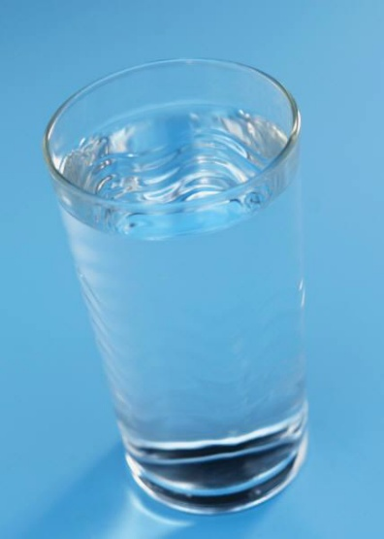
Program Benefits
Higher Quality Water
Regulatory Compliance
Customer Satisfaction
Employee Involvement
Understanding What’s Happening
Creation of an In-house Culture to Achieve Best Practices
Recognition Awards

Slide 22
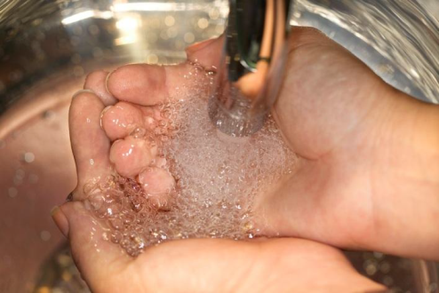
PWD DSOP
Lessons Learned:
Differing perspectives
SME interviews revealed differences in opinions
Discuss to be sure that all perspectives are understood and heard
Beyond Partnership
Actions suggested by SMEs were not limited to PSW topics – they are being addressed thru the PI² list
Self-assessment is not limited to PSW topics/questions and can be utility specific – it’s a resource

Slide 23
PWD DSOP
Most Valuable Lesson/Experience:
Role of Younger Professionals
Brought a lot of talent, enthusiasm, and tools (SharePoint) to the project
Give them the leeway to manage the project as self-assessment team members
Beneficial opportunity for learning, information transfer, and networking within organization
Career development potential

Slide 24
PWD is a Distribution System Optimization Program FOUNDER
PWD Joined the Distribution System Optimization Program on March 28, 2011
PWD will be designated a FOUNDING MEMBER in all communications & on awards
– Utility will be able to fast-track their self-assessment
– receive the Directors Award
– provide feedback to improve the program

Slide 25
PSW Contacts
Partnership for Safe Water Website, www.partnershipforsafewater.org
Barb Martin, AWWA Program Manager,
303-347-6220, blauer@awwa.org
Bob Donnelly, PaAWWA Representative,
570-239-6715, rdonnellypaawwa@aol.com

Slide 26
Distribution System Integrity
System Integrity Performance Indicators
Water Quality
Maintain Disinfectant Residual
Hydraulics
Maintain Positive Pressure
Physical
Main Break Frequency Reduction
System Integrity may be at risk when these performance indicators are not optimized
Notes:
In PSW DSOP, there are three main indicators for distribution system integrity performance.
Water Quality, particularly in regards to maintaining disinfectant residual, is a crucial optimization component in preserving distribution system integrity.
If all three integrity components are optimized, high water quality and system reliability can be enhanced.

Slide 27
Pressure Data
13 separate pressure districts
This year, each district was analyzed separately
31 pressure sensors throughout the system
13 pressure sensors studied; 1 for each pressure district
Hydraulic model utilized to determine the low and high pressures
Notes:
The pressure sensors provide real-time pressure to Load Control’s Supervisory Control And Data Acquisition system. These sensors at located on supply lines to city owned buildings such (PWD, PFD, PPD).
Unlike the previous year where all 13 pressure districts were analyzed as a whole in one Excel file, this year each pressure district was studied separately.
Main break as a PLF – Christine to talk about use of CapPlan – Phase III Report

Slide 28
Pressure Data
An optimized water system maintains ≥ 20 psi in 99.5% of measurements (from hourly readings)
Notes:
Optimized pressure management numerical goals take into account the widely accepted minimum of 20 psi and utility specific goals
Pressure must be monitored continuously
PWD used 30 minute average rather hourly
There were three parameters monitored for each pressure district
Min Pressure – 227, 760 data points analyzed for minimum pressure
Max Pressure
Single Site Maximum Range
Each parameter had 48 ½ hour records equating to 51,750 data points per month (17,250/parameter/month_
This resulted in 672,750 unique data points collected for analysis
The method of data collection and analysis went beyond the minimum partnership requirements providing what the PWD thought was best rather than what the Partnership called for

Slide 29
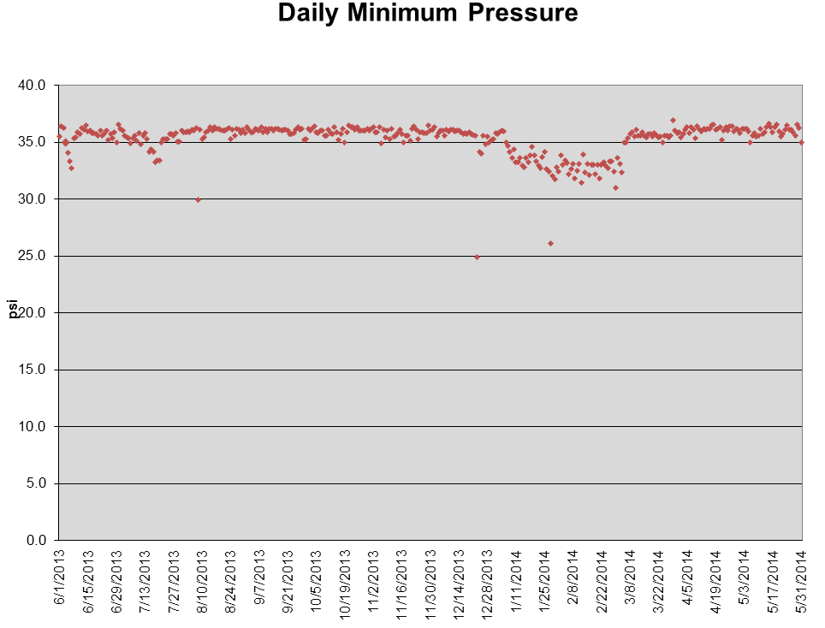
Pressure Data
Partnership software pressure trend
Notes:
This is just an example of one of the graphs provided by the partnership software

Slide 30
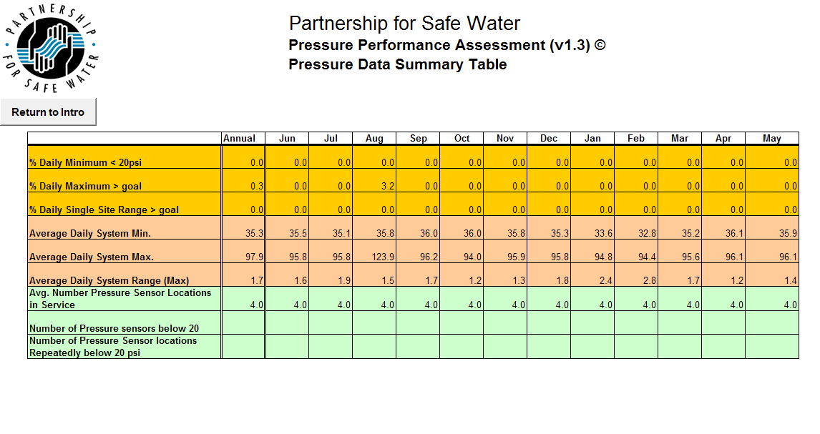
Pressure Data
Annual Pressure Data Summary Table
Notes:
Summary table from the Partnership software averaging daily pressure data

Slide 31
Distribution System Integrity
System Integrity Performance Indicators
Water Quality
Maintain Disinfectant Residual
Hydraulics
Maintain Positive Pressure
Physical
Main Break Frequency Reduction
System Integrity may be at risk when these performance indicators are not optimized
Notes:
In PSW DSOP, there are three main indicators for distribution system integrity performance.
Water Quality, particularly in regards to maintaining disinfectant residual, is a crucial optimization component in preserving distribution system integrity.
If all three integrity components are optimized, high water quality and system reliability can be enhanced.

Slide 32
Main Break Data
PWD Main Break Definition:
A water main break is defined as a structural defect in a water main, fire hydrant lateral, tapping sleeves or saddles that cause an interruption in service. Breaks include pin hole leaks, circumferential, longitudinal and bell cracks on water mains. Repair clamps are installed on pin hole, circumferential and longitudinal to stop the water flow. Bell cracks are repaired by cutting out a section of the connecting pipes and inserting a straight piece to repair with clamps on each side. Hydrant laterals are included in the count of water main breaks recorded.
Notes:
This is the official definition of what the PWD considers a main break
NOTE: The partnership includes breaks and leaks on appurtenances such as valves, hydrants, blowoffs, fittings, tapping sleeves and saddles and the connected tapping valves and corporation stops.
The PWD does not include valves, blowoffs, fittings, tapping valves or corporation stops

Slide 33
Main Break Data
PWD Fiscal Year (July 1 - June 30) | Main Breaks Per 100 miles | 5-year Moving Avg. | Total Miles of Pipe
1994 | 42 | 25 | 3,300
1995 | 29 | 26 | 3,300
1996 | 23 | 26 | 3,300
1997 | 16 | 26 | 3,300
1998 | 14 | 25 | 3,300
1999 | 20 | 20 | 3,300
2000 | 27 | 20 | 3,300
2001 | 19 | 19 | 3,300
2002 | 21 | 20 | 3,300
2003 | 26 | 23 | 3,300
2004 | 25 | 24 | 3,300
2005 | 25 | 23 | 3,300
2006* | 17 | 23 | 3,133
2007* | 26 | 24 | 3,137
2008 | 19 | 22 | 3,137
2009 | 22 | 22 | 3,145
2010 | 22 | 21 | 3,159
2011 | 31 | 24 | 3,164
2012 | 17 | 22 | 3,172
2013 | 30 | 24 | 3,174
DSOP Performance goals:
1) ≥ 15 reported breaks per 100 miles
2) Declining 5-year trend
Notes:
Prior to 2006 an estimate of 3,300 miles of water mains was used with data taken from historic records
From 2006 through 2013 data from GIS was utilized for the total miles of pipe
When analyzing main break data, the PWD employs a 15-year rolling average to dampen the spikes caused by sporadically extreme winter conditions.
Most of the system (~70%) is unlined cast iron with the remaining consisting of cement lined DI (post 1967)
Compared to the previous Partnership year there was a main break increase of 79.3%
The winter months during this partnership year saw a 30% increase in the total number of days where ambient temperatures were below 32 degrees
During these months water temperature averages around 33 to 34 degrees Fahrenheit compared to summer months where water temperature can exceed 80 degrees
This colder water temperature combined with the freeze/thaw action in the ground can directly affect the mains during this period by causing increased external stress on a pipeline.
Historically nearly 50% of the Philadelphia Water Departments (PWD) main breaks occur in December, January and February.

Slide 34
Main Break Data

Slide 35
Main Break Data

Slide 36
Distribution System Integrity
System Integrity Performance Indicators
Water Quality
Maintain Disinfectant Residual
Hydraulics
Maintain Positive Pressure
Physical
Main Break Frequency Reduction
System Integrity may be at risk when these performance indicators are not optimized
Notes:
In PSW DSOP, there are three main indicators for distribution system integrity performance.
Water Quality, particularly in regards to maintaining disinfectant residual, is a crucial optimization component in preserving distribution system integrity.
If all three integrity components are optimized, high water quality and system reliability can be enhanced.

Slide 37
System Integrity Performance Indicators – Water Quality
Maintaining adequate Disinfectant Residual throughout the distribution system is integral to ensuring drinking water quality
State and federal requirements:
MRDL (chloraminated systems) = 4.0 mg/L
Entry Point Minimum = 0.2 mg/L
Distribution System Minimum = 0.02 mg/L
< 0.02 mg/L is considered non-detectable
System Integrity may be at risk when these performance indicators are not optimized
Notes:
Disinfectant Residual has been identified as a useful indicator of water quality integrity.
As a result of this indication, there are state and federal disinfectant residual-related requirements applicable to surface water systems and some groundwater systems.
The federal requirement regarding the maximum residual disinfectant level (MRDL) for chloraminated systems, like PWD, is 4.0 mg/L.
The disinfectant residual concentration in the water delivered in the distribution system prior to the first customer may not be less than 0.2 mg/L.
In the distribution system, as a minimum, the detectable disinfectant residual concentration may not be less than 0.02 mg/L.
Any disinfectant residual less than 0.02 mg/L is considered non-detectable and in order to be in compliance with PaDEP, the primacy agency, in these situations heterotrophic plate count (HPC) must be less than 500 cfu/mL.

Slide 38
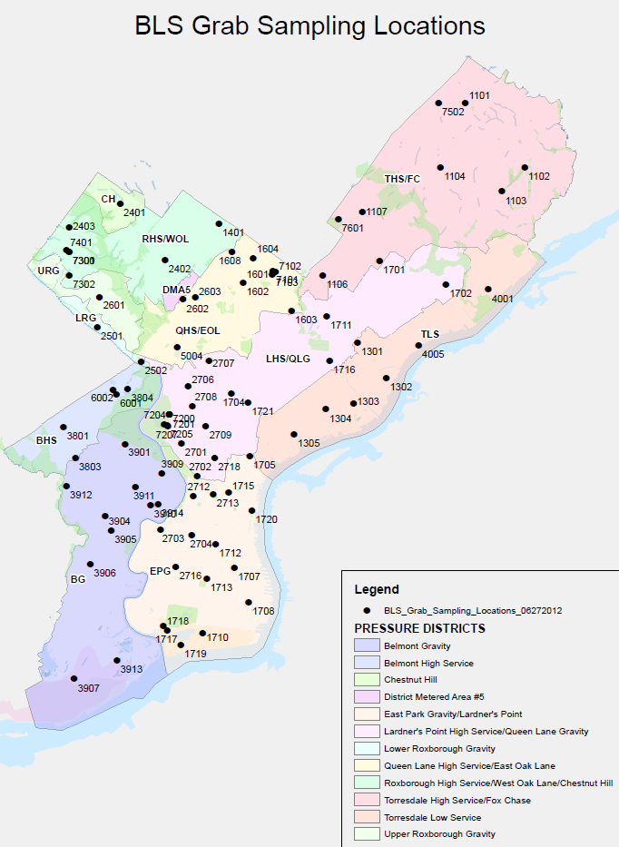
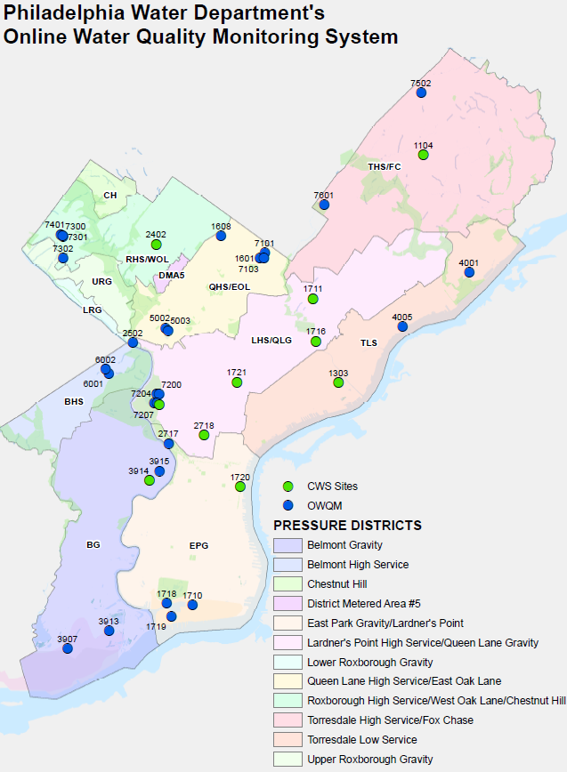
Water Quality – Disinfectant Residual
Routine Sampling Program
Grab samples are collected at representative locations throughout the distribution system
80+ grab sample locations
Pre-determined sampling frequency schedule
Cl₂ values represent water “from the main”
Continuous online analyzers
36 stations with multiple sensors: Cl₂, pH, turbidity, temperature, conductivity, ORP, pressure, flow
Notes:
How does PWD manage disinfectant residual?
PWD has an extensive monitoring program.
The program is a “routine” sampling program where a targeted set of grab samples are collected as consistently as possible at similarly spaced time intervals. Collectively, and individually, these sites were strategically selected to represent water quality conditions throughout the distribution system.
The sampling frequency is higher at key locations in the system (treatment plants, pumping stations, and storage facilities – reservoirs and standing pipes).
Procedures are in place so that the when samples are collected, the disinfectant residual values (or other parameters) measured, represent water “from the main” at the sample site versus water within the customer supply lines or after excessive flushing.

Slide 39
PSW Water Quality Site Location Parameters
Key optimization site testing locations include:
All finished water entry points and metering points to other systems
Stage 1 and/or Stage 2 DBP sites
IDSE or “IDSE-type” sites
Downstream of storage facilities
Areas served by older unlined cast iron mains
Low flow areas
Known high water age areas
Notes:
To achieve full optimization, systems must frequently test at all system entry points, downstream of storage facilities, and other key optimization sites.
Other key optimization sites are those where systems should sample within known high improvement performance potential areas – aka “problem sites” (areas served by older unlined cast iron mains, low flow areas, known high water age areas).
Additionally, systems should include other sites as needed for representation of all pressure zones.
As previously shown, PWD has an extensive representation of sampling location sites.

Slide 40
PSW Water Quality Goals
Optimized systems must meet the following criteria:
Chloraminated systems - 95% of monthly measurements at each sample site and for the system overall:
Total Chlorine ≥ 0.50 mg/L and ≤ 4.0 mg/L
No consecutive disinfectant residual measurements at optimized individual routine sample locations < 0.50 mg/L and > 4.0 mg/L
Sample locations include all optimization site testing locations meeting the previously mentioned site location parameters
DBPs do not exceed regulatory limits and methods are employed to maintain or reduce DBPs
Notes:
According to PSW, to be deemed optimized in regards to disinfectant residual performance, PWD must meet a numerical residual performance goal using the representative samples collected frequently from throughout the distribution system.
For chloraminated systems, the disinfectant residual goal is that in 95% of monthly measurements at each sample site and for the system overall must have total chlorine residual ≥ 0.50 mg/L and ≤ 4.0 mg/L.
PSW does not consider a system to be “optimized” if there are consecutive* disinfectant residual measurements at optimized individual routine sample location that are < 0.50 mg/L and > 4.0 mg/L.
Sample locations must include all optimization site testing locations (as previously mentioned).
DBPs (TTHMs & HAA5) do not exceed regulatory limits for each sample tested and methods are employed to maintain or reduce levels even though disinfectant residual levels may be increased at individual sites.

Slide 41
PSW Water Quality Software
Data collection software allows data to be inputted for a 12-month period (June 1 – May 31)
Software calculates statistics to help aid in data analysis
Data requirements:
Daily average Cl₂ residual for all entry points (from continuous online monitors at WTPs)
Daily Cl₂ residual results, software tracks:
Daily minimum Cl₂ residual
Sites with Cl₂ < 0.50 mg/L
DBP monthly results – software tracks:
Max DBP results
Notes:
The data collection software from PSW for disinfectant residual was used for the baseline report and is used for the annual reports.
The software allows for data from a 12-month period.
PSW software calculates statistics based on data entered into the program.
What data is inputted into the software? And how is it used?
Daily average chlorine residual for all entry points (WTP personnel give BLS this data from the continuous online monitors at the WTP)
Daily chlorine residual results from all routine sampling program locations. The software tracks daily minimum chlorine residuals, the number of samples not meeting PSW disinfectant goal, and the site location(s) where samples collected are not meeting the PSW disinfectant goal.
DBP monthly results from 16 sites in the routine sampling program. The software tracks the maximum DBP results by month

Slide 42
PWD Water Quality Performance
June 1, 2013 – May 31, 2014:
8,784 routine samples
98.9% Cl₂ results ≥ 0.50 mg/L
1.1% < 0.50 mg/L
23 repeat non-conforming* sites
June 1, 2012 – May 31, 2013:
8,543 routine sample
97.8% Cl₂ results ≥ 0.50 mg/L
2.2% < 0.50 mg/L
42 repeat non-conforming* sites
 | Annual | Jun | Jul | Aug | Sep | Oct | Nov | Dec | Jan | Feb | Mar | Apr | May
Entry Points Residual Average (mg/L) | 2.32 | 2.44 | 2.56 | 2.56 | 2.38 | 2.41 | 2.19 | 2.16 | 2.20 | 2.24 | 2.25 | 2.25 | 2.22
Number of Routine Samples | 8784 | 730 | 805 | 791 | 737 | 805 | 661 | 732 | 694 | 584 | 723 | 761 | 761
Number of Routine Test Results Not meeting Goals | 96 | 0 | 8 | 26 | 35 | 20 | 6 | 0 | 1 | 0 | 0 | 0 | 0
% Routine Test Results Not Meeting Goals | 1.09 | 0.00 | 0.99 | 3.29 | 4.75 | 2.48 | 0.91 | 0.00 | 0.14 | 0.00 | 0.00 | 0.00 | 0.00
Minimum Daily Residual Value (mg/L) | 0.05 | 0.70 | 0.15 | 0.15 | 0.10 | 0.20 | 0.05 | 0.64 | 0.05 | 1.10 | 1.48 | 1.10 | 0.95
Number of repeat non-conforming sites | 23 | 0 | 2 | 6 | 9 | 5 | 1 | 0 | 0 | 0 | 0 | 0 | 0
TTHM Maximum (µg/L) | 143.00 | 115.00 | 143.00 | 81.40 | 82.30 | 69.10 | 50.10 | 39.10 | 24.20 | 18.20 | 27.20 | 34.90 | 37.10
HAA5 Maximum (µg/L) | 136.21 | 90.81 | 136.21 | 77.65 | 31.87 | 25.01 | 25.40 | 63.94 | 32.88 | 22.44 | 30.97 | 33.83 | 59.71
Notes:
How well is PWD meeting PSW goals?
The most recent study period (June 1, 2013 – May 31, 2014) is an improvement from the previous one. It is also very similar to the baseline study period results (June 1, 2011 – May 31, 2012).
During the most recent study period, the number of samples has increased (300+ from previous study period, 350+ from baseline study period).
Compared to the previous study period, the percent of test results in the most recent study period meeting PSW disinfectant goal has increased, as the number of results not meeting the goal has decreased. The same progress was also experienced during the baseline study period.
*Repeat non-conforming is terminology from PSW. It is designed to indicate the number of sites during a monthly period that have “consecutive” results that do not meet PSW disinfectant goal. However, there are some software limitations and other issues in regards to calculating this number. PWD has informed PSW about this issue and has suggested the use of alternate terminology.

Slide 43
PWD Water Quality Performance
For PWD, sample results not meeting the PSW Cl₂ goal, usually occur when water temperatures are elevated
August, September – almost always difficult to meet PSW Cl₂ goal
July, October – can provide challenges to meeting PSW Cl₂ goal
Most recent study period
significant improvement from previous study period

Slide 44
PWD Response to Declining Water Quality
Continual, cyclical effort among various PWD units:
Treatment
Cl₂ progressions
BLS & Load Control
WQ monitoring
Trigger levels
Investigation & remedial actions
Flushing, valving, and water movement operations
Improves response to declining water quality
Treatment establishes and provides various PWD units with target Cl₂ goals
If needed, Load Control performs investigation & remedial actions
BLS performs daily monitoring (chemistry & bacteriological)
Water Quality Monitoring and Response Cycle
BLS performs investigation & remedial actions
Trigger values may indicate enhanced monitoring is needed
Notes:
What drives PWD improvement in PSW DSOP?
A continual, cyclical effort toward distribution system optimization has driven the improvement of chlorine residuals throughout the distribution system.
PWD’s Treatment unit provides communication to other PWD units whenever chlorine residual goals may change. This is particularly important during warmer weather months, when PWD usually experiences declining chlorine residuals in the distribution system. Though water temperatures cannot be controlled, chlorine dosages can. Therefore, PWD Treatment established warm water progressive chlorine residual goals. These goals allow other units an approximation in regards to what kinds of chlorine residuals can be expected throughout the various districts.
PWD BLS monitors chemistry and bacteriological parameters daily and has various trigger values, that when exceeded require action. PWD BLS designates sites with declining residuals to be on enhanced monitoring for chemistry and bacteriological parameters; additional parameters or samples may also be analyzed. Additionally, PWD BLS performs site investigations to determine any contributors to declining residuals. This involves testing water for various parameters from various hydrants at and around the site with declining residual to better understand chlorine trends in the area of concern. The investigation at the site may also include a brief plumbing inspection and sampling collection.
Based on BLS’ investigation, the Load Control unit may be contacted for further assistance. Load Control performs investigations in regards to valving, water movement, and flushing techniques. Together, all of these operations have proven to be beneficial at sites with declining residual levels. Ultimately, careful planning, attention, and inclusion of various units throughout PWD, helps improve sites with declining chlorine residual.

Slide 45
Under PSW DSOP …
Significant improvements in water quality
PWD can better track and trend Cl₂ levels as changes are identified and implemented
Identify “problematic sites”
Improve water quality response & mitigation
Multiple PWD units collaborate to solve water quality problems and gain knowledge of practices in other units

Slide 46
PSW & PaDEP Reporting of Disinfectant Residual
PaDEP requirement at the entry point:
0.2 mg/L
PaDEP minimum requirement in distribution system:
0.02 mg/L
PSW DSOP goal disinfectant residual
≥ 0.5 mg/L
Difficult to meet this goal
During summer months, PWD comes close to not meeting the PSW disinfectant goal
In some years, PWD has not met this goal
Notes:
At the entry point, PaDEP requires the chloramine disinfectant residual to be 0.2 mg/L.
The PaDEP also requires the minimum chloramine disinfectant residual within the distribution system to be at least 0.02 mg/L.
For the short term time period, the PSW goal is difficult to attain. PWD has not met the disinfectant residual goal in the past, or often comes close to not meeting the goal. It has been proven that chloramine levels of 0.2 mg/L provide sufficient microbial protection as indicated by the entry point regulatory limits and would be a more acceptable goal for chloramine utilities.

Slide 47
DSOP PLF Identification
During the SA process, a comprehensive summary of questions for assessing optimization were examined and responded to as:
Optimized & Documented
Partially Optimized
Not Optimized
If identified as partially optimized or not optimized:
The item must be improved to achieve optimization OR
Justified as to why it is not an issue for the PWD distribution system
Notes:
The self-assessment process allowed PWD to gather information on system performance and factors that could be limiting performance in the areas of design, operations, and administration.
PSW provided lists of factors that the assessment team could examine and check as optimized and documented, partially optimized, or not optimized.
By checking a factor as partially optimized or not optimized, the assessment team is identifying it as an item that must be improved to achieve optimization or justified as to why it is not an issue for the PWD distribution system.

Slide 48
PLF Prioritization
After PLF categories were identified, they were prioritized in order of:
Impact
Urgency
Unit(s) were assigned in regards to responsibility for improving the identified PLF
Impacts categories were identified:
Water Quality
Cost
Main Breaks
Security
Customer Service
Infrastructure Reliability
Operational Practices
Water Quality Model Updates

Slide 49
DSOP Findings - PLFs
Self-assessment Process identified 14 PLFs (21.5%) and the group(s) assigned to evaluate the issue:
1- Disinfectant Residual BLS, WT, WC
2- Main Break Management P&R, LdC
1- Flushing WC
2- Maintain Valves, Hydrants WC
1- Internal Corrosion Control WC, P&R
1- Nitrification Control BLS
3- Post Precipitation Control BLS, WT, P&R, WC
1- Security, E-Management LdC, WT
1- Water Age Management BLS
1- Chapter 4 – Update Model LdC

Slide 50
PLF – Nitrification Control
Self-assessment Category | Questions for Gauging Optimization | Response |  |  | Prioritization |  |  | Assigned Group(s) (preliminary) | Impacts (preliminary) | PLF Comments
 |  | Not Optimized | Partially Optimized | Optimized and Documented | Impact | Urgency | Priority Total
 |  |  |  |  | 1 - 5 | 1-2-3 | Total
Nitrification Control
(Systems that utilize chloramine disinfection)
Nitrification Control | Are disinfectant residuals maintained > 0.50 mg/L total chlorine? Are storage tanks monitored in areas lacking circulation? Are zone boundaries and dead ends monitored for nitrification? |  | x |  | 3 | 2 | 5 | BLS | WQ | Partially Optimized for chlorine residual but Optimized for monitoring of nitrification
Optimized and Documented in regards to:
routinely monitoring for free ammonia, nitrite, and HPC
establishing action levels associated with nitrification
Partially Optimized in regards to:
maintaining Cl₂ residual > 0.5 mg/L

Slide 51
PWD Findings – PI²
Self-assessment Process identified 73 PWD Improvement Initiatives (PI²) and the group(s) assigned to evaluate the issue:
Water Master Plan Project Team 9
SME statements (NFAR) 7
Unit Manager Assignments 57
WC – 15 BLS – 14 CA - 11
P&R – 10 HR – 6 WT – 1
Note: NFAR; no further action required

Slide 52
PI² – Nitrification
Performance Improvement Variable (Self-assessment Category) | Subject Matter Experts Comments PWD Improvement Initiatives (PI²) | PLF Category |  |  | Priority |  |  | Time Frame |  |  | Comments from Steering Committee Members at Workshop Meetings (Responsible Party in Bold)
 |  | System Design | Operations & Maintenance | Administrative | Low | Medium | High | Short Term | Medium Term | Long Term
PIV Category | SME Comments | D | O&M | A | L | M | H | 1-3 Yr | 4-9 Yr | >10 Yr
Nitrification
Budget; staff retention | Staff turnover, especially in SRA (sampling techs and instrument techs) is making it difficult to conduct program responsibilities. Experience and knowledge is lost due to turnover. Options include; Increase pay or provide incentives for staff to stay, increase budget to pay for increased salaries, have HR advertise about in-house position transfer opportunities to BLS. The additional responsibilities that come with being part of DSOP make staff retention even more of a priority. |  |  | x |  | x |  |  | x |  | The Steering Committee decided that PWD's HR needs to evaluate a method to keep these positions filled; either upgrade the pay levels or establish an internal training program to produce a pool of candidates. A suitable hiring list must be established to fill existing approved vacancies. HR is to be requested to prepare an annual update report and to provide a copy to the PWD DSOP Program Manager.
Capital Investment; replace oversized water mains and valves | Oversized mains lead to longer water age, observations of reduced chlorine residual and the potential for nitrification to occur. Flushing larger mains are only marginally effective. Down-sizing parts of the water distribution system can be an effective solution to lower water age, achieving chlorine residual goals and minimizing nitrification, as long as sufficient fire flow can be maintained. Chlorine residual upkeep is an integral part of DSOP. Finding the money for construction projects that deal with downsizing mains should be a priority. | x |  |  |  |  | x |  |  | x | The Steering Committee discussed this issue and appreciates the importance of the suggestion. The PWD asset management program already considers this issue in the evaluation of water delivery requirements. The SC decided that this issue be evaluated by the project team preparing a Water Master Plan. An annual report should be prepared and forwarded to the PWD DSOP Program Manager.
Budget , training and capital investment were common concerns among the various Subject Matter Experts (SME) interviewed.
Throughout the SA process, many PI²’s were referred to the Water Master Plan Project team. Others were assigned to the Unit Managers suggesting the improvement initiative.
Notes:
Budget and training were common concerns among the various Subject Matter Experts (SME) interviewed.
Throughout the SA process, many other PI²’s were referred to the Water Master Plan Project team. Others were assigned to the Unit Managers suggesting the improvement initiative.

Slide 53

Self-Assessment Process
Notes:
In PSW DSOP, there are three main indicators for distribution system integrity performance.
Water Quality, particularly in regards to maintaining disinfectant residual, is a crucial optimization component in preserving distribution system integrity.
If all three integrity components are optimized, high water quality and system reliability can be enhanced.

Slide 54
PWD Approach
PWD allocated an incredible amount of resources to the Partnership.
“all-in” approach
Multi-faceted success
Identify.
Partnership process and goals
Overarching PWD goals.
Vehicle to meet goals within partnership framework.

Slide 55
PWD Approach
Departmental goals.
Bridge departmental lines
Invigorate interdepartmental relationships
Dissemination of a wealth of critical knowledge
Vehicle for solutions.
Mass engagement
Young professionals in contrast with seasoned experts
Departmental “cross-pollination”

Slide 56
PWD Self-Assessment Process
People
Steering Committee
6 members
Self-assessment team (SA)
8 members
Subject matter expert (SME)
33 members

Slide 57
PWD Self-Assessment Process
Tasks
SA team members split the 19 PIV’s
Each PIV was then assigned 2-5 SME’s
Each SME was interviewed
Notes were recorded
Individual interview summary reports were created and submitted to the SME for sign-off.
Each of the reports for individual PIV’s were reviewed and compiled into 1 summary report per PIV.

Slide 58
PWD Self-Assessment Process
Tasks
The PIV summary reports were then submitted to the SC for an interactive iterative review.
After the PIV summary reports were accepted, the SC addressed every item in the reports.
PLF (potential limiting factors)
PI² (performance improvement initiatives)
Discussion
These items became the basis of the SA.

Slide 59
PWD Self-Assessment Process
Engagement
63 SME interviews were conducted in total.
SA team members were strongly encouraged to attend any and all interview sessions
Cross-pollination
Iterative process fostered cross departmental cooperation.
Knowledge dissemination
Fostered professional relationships

Slide 60
Main Break Goals
PWD is partially optimized when compared to the PSW DSOP main break goals:
Does the system meet the main break goals?
No more than 15 reported breaks and leaks per 100 miles of distribution and transmission piping per year.
Declining rolling 5-year Main Break frequency trend (most recent 5 years).
PWD Average: 23.2 breaks/100 miles per year and increasing rolling 5-year main break trend

Slide 61
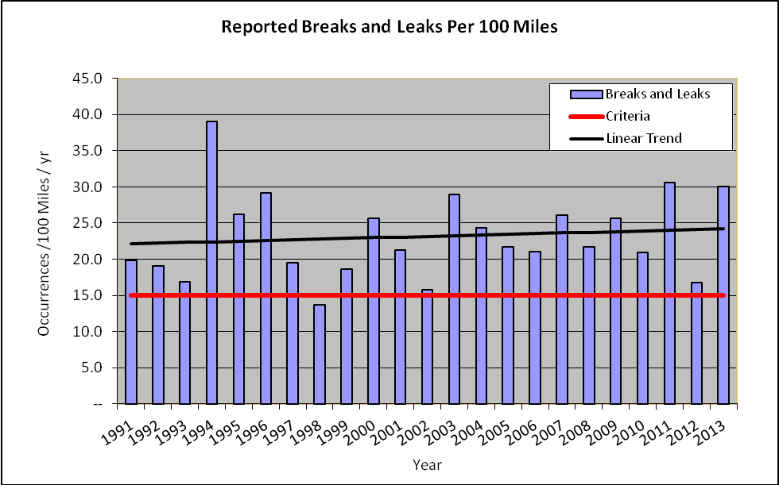
Main Break Goals
Graph taken from Water Distribution System Optimization Program 2nd Annual Report, Brendan F. Reilly
Notes:
23 years of historic data
1998 PWD met the partnership goal

Slide 62

Linear Asset Management Program
KANEW
(Annual Long-Term Renewal Quantity)
Budget & Planning Details
Coordination Activities
Budget & Planning Details
Coordination Activities
Assemble & Track Capital Projects
CapPlan - Water
(Pipe Segment Prioritization)
Outputs (New & Rehabilitated Assets)
LEYP
(Factor Correlation & Break Prediction)
CapPlan - Water
(Pipe Segment Prioritization)
LEYP
(Factor Correlation & Break Prediction)
Pipe Criticality
Budget Information
Other Infrastructure Project Interactions
Pipe Criticality
Budget Information
Other Infrastructure Project Interactions
Pipe Information
(Breaks, Leaks, O&M Data, GIS Data, Pipe Samples, Hydraulic Model Outputs, Old Descriptive Statistics, etc.)
Cityworks
™

Slide 63
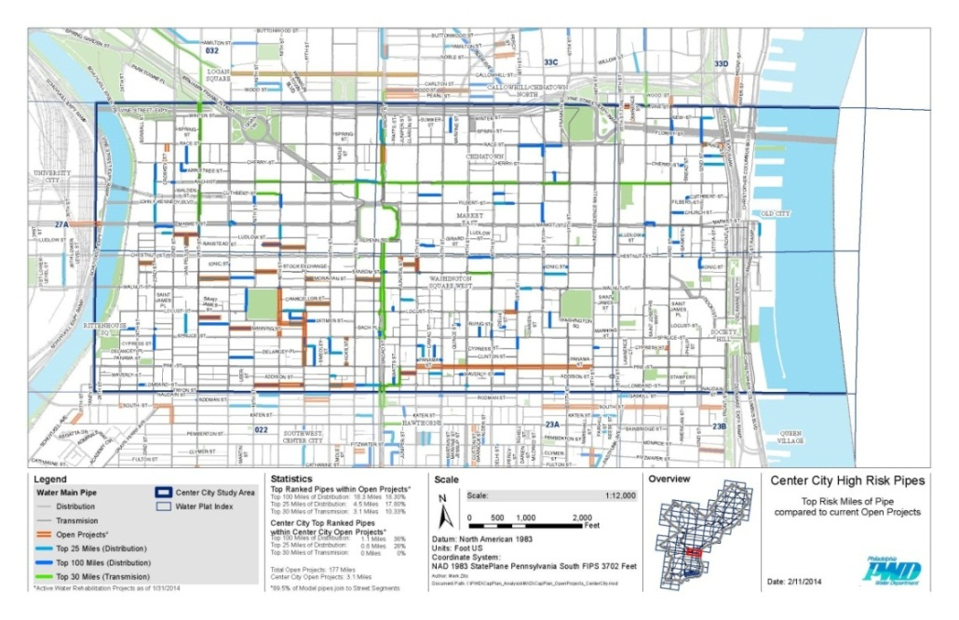
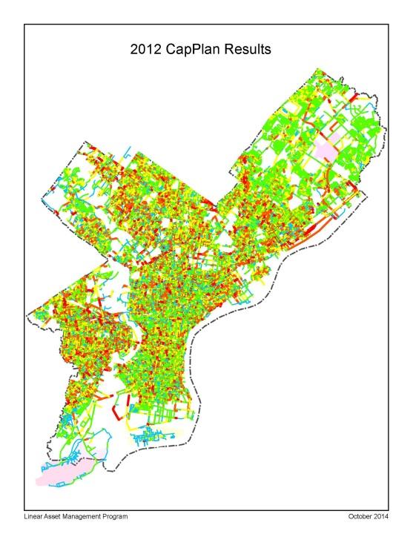
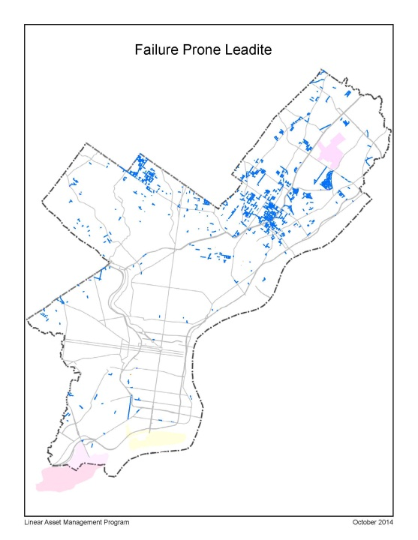
Linear Asset Management Program
FY14/FY15 Accomplishments
LAMP working group established – Design, Operations, P&R
Identified study areas for targeted renewal:
Center City,
Leadite Joints
Pre-1900 piping
Fire Flow availability
Transmission Piping
Completed “Failure Prone Leadite” study
FY15/FY16 Goals:
Develop CapPlan manual for PWD
FY15 CapPlan model run
Establish new renewal methodology
Notes:
Failure Prone Leadite study -
103 miles identified,17 miles in Open Projects (End of FY2014)
Package projects to remove leadite joints

